Slide 1
Breakout

Slide 2
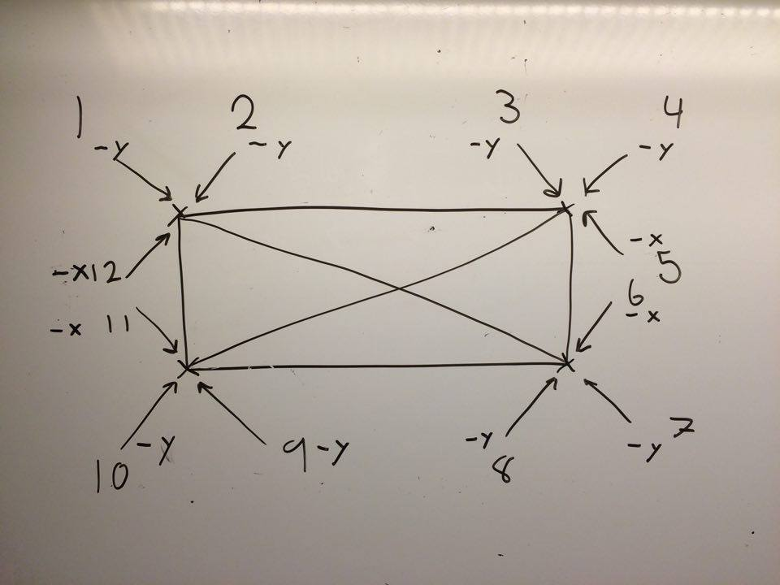
Hitcheck mellan boll och block void Block::hitCheck(Boll& boll, Score& score)
if (getHBbottom().containsPoint(point, Qt::OddEvenFill))
{
if ((boll.xvel() > 0) && (boll.yvel() > 0))
{
boll.changexvel(-1);
breakBlock(score); return;
}
if ((boll.xvel() < 0) && (boll.yvel() > 0))
{
boll.changexvel(-1);
breakBlock(score); return;
}
boll.changeyvel(-1);
breakBlock(score);
return;
}

Slide 3
Breakblock()
void Block::breakBlock(Score& score)
{
_isActive = 0;
score.addScore();
_sound->play();
}

Slide 4
Update() Spawning av powerups
//Blockhitcheck samt skapar ev powerups
for (int i = 0; i < _blocks.size(); i++)
{
//Kollar block- och bollkollision samt adderar till score om träff
_blocks[i]->hitCheck(*boll, *score);
//Om blocket har powerup, inte är aktivt och har kvar sin powerup
if (_blocks[i]->hasPowerup() && !_blocks[i]->isBlockActive() && !_blocks[i]->isPowerupTaken())
{
_blocks[i]->setPowerupTaken(1);
srand(time(NULL));

Slide 5
//Skapar powerup
int r = rand() % 4;
if (r == 0 || r == 1)
{
Powerup* p = new PowerupSpeed(_blocks[i]->getX(), _blocks[i]->getY(), boll, rack);
_powerups.push_back(p);
}
else if (r == 2)
{
Powerup* p = new PowerupInvisible(_blocks[i]->getX(), _blocks[i]->getY(), boll, rack);
_powerups.push_back(p);
}
else if (r == 3)
{
Powerup* p = new PowerupRacket(_blocks[i]->getX(), _blocks[i]->getY(), boll, rack);
_powerups.push_back(p);
}
}
}

Slide 6
Effekt från powerupSpeed
void PowerupSpeed::giveEffect()
{
timer->start(POWERUP_TIME_MS);
givingEffect = 1;
_boll->speedUp();
}
void Boll::speedUp()
{
_baseVel = BOLL_POWERUPSPEED;
_speed->play();
}
void PowerupSpeed::powerupEnded()
{
_boll->slowDown();
givingEffect = 0;
}
void Boll::slowDown()
{
_speed->stop();
_baseVel = BOLL_BASESPEED;
}

Slide 7
Hitcheck mellan racket och boll
void Racket::hitCheck(Boll& boll) const
{
QPoint bollCenter = boll.position().center();
if (rect->contains(bollCenter))
{
float MAX_BOUNCE_ANGLE = 4 * (PI / 12);
float relativeIntersectX = rect->center().x() - bollCenter.x();
float normalizedRelativeIntersectionY = (relativeIntersectX / (rect->width() / 2)) + 1.5;
float bounceAngle = normalizedRelativeIntersectionY * MAX_BOUNCE_ANGLE;
boll.setxvel(cos(bounceAngle));
boll.setyvel(-sin(bounceAngle));
_sound->play();
}
}

